Slide 1

Managing an Online Book Store
Presenter: Task Titans

Slide 2

Content
1. About the Project
2. Project Scope
3. Work Breakdown Structure
4. Milestones
5. System Design / Architecture
6. System Requirements
7. Deliverables
8. User and Functional Requirements
9. Inputs and Outputs
10. Schedule and Delivery Plan

Slide 3
Title of Project: Managing an Online Book Store
Team Name: Task Titans
Mentor Name: Neetesh Parashar
Team Members:
J. Varun Kumar
K. Dheeraj Kumar
K. Manikanta Vinayak
A. Vinay Kumar
A. Charan Kumar
Project Lead: J. Varun Kumar

Slide 4

Brief Summary of My Project
The most general goal of the project managing an online bookstore is to create a new concept of online bookstore that create a better interface and better experience for buyers and sellers. This is a friendly and responsive website friendly to its users. The[This] platform offers the authorized and widespread books.

Slide 5

Project Scope
Developing an online selling strategy for books targeting small book shops that would make it easy and fun to shop.
The main features accessible for the users are, login, books’ list, shopping cart, orders management, rating and review system, recommendatory system and security.

Slide 6
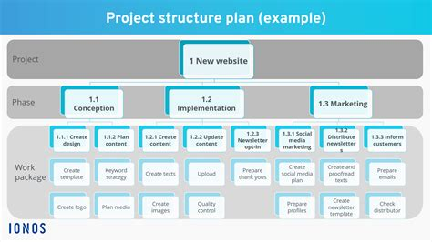
Work Breakdown Structure

Slide 7

Milestones
Finalize project goals, objectives, and team roles
Gather and document detailed requirements
Maintain software requirement specifications document in Documentation process
Develop and approve the project plan and timeline
Review and finalize design prototypes
Complete development of user interfaces
Complete development of server-side logic
Complete unit testing for all modules
Test interactions between different system components
Perform testing with actual users and stakeholders

Slide 8
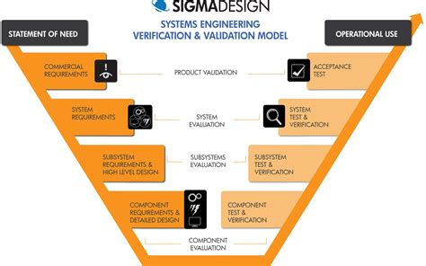
System Design / Architecture

Slide 9

System Requirements
Server: A reliable server for managing the traffic, memory, storage and processing power.
Operating System: A reliable os for application to work on.
Database: A data base system to maintain all the data about books and customer data.
Security Software: Firewalls and security measures to protect user data .

Slide 10

Deliverables
E-commerce Website
Shopping Cart & Checkout
Order Management System
Inventory Management System
Project Documentation
Source Code

Slide 11

User Requirements
Account Management
Browsing and searching
Product Information
Shopping cart
Checkout
Order Tracking
Ratings and Reviews
Notifications
User Support
Security and Privacy

Slide 12
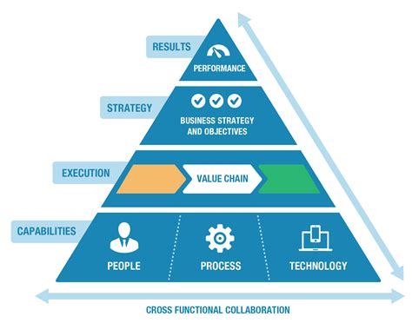
Functional Requirements
User Registration and Authentication
Role based access control
Book listing
Stock management
Help centre
Feedback and complaints
Responsive Design

Slide 13

Inputs and Outputs

Slide 14

Schedule and Delivery Plan

Slide 15

Thank You

